Slide 1
Life cycle of an event - ChatOps
Robert Barron
Snr. Solution Engineer
Cloud Adoption, Garage Method, and Solution Engineering
IBM Cloud

Slide 2
Challenges with today’s IT landscapes –another reality!
… managing today’s applications is difficult because symptoms may not be visible
Mean Time to Repair for application-related problems is often 3-6 hours
Issues that go beyond Level 1 support often involve at least 3-4 people taking up an average of 5-7 total man hours
Increasingly complex hybrid cloud environments
User calls to applications support are the enterprise’s “heads up” for an application problem 35% of the time
58% of survey participants said their enterprise had between 6 and 40 different monitoring tools
Gartner – By 2018, 50% of the applications running in public cloud environments will be considered mission-critical by the organizations that use them.
IDC - By 2018, Over 60% of new apps will use cloud-enabled continuous delivery and cloud-native application architectures to enable faster innovation and business agility.
IDC FutureScape: Worldwide Cloud 2016 Predictions -Mastering the Raw Material of Digital Transformation, IDC, Nov. 3, 2015
Gartner Predicts 2016: Cloud Computing to Drive Digital Business 12/8/15 G00292047
2
Notes:
Challenges from the perspective of monitoring and managing rapidly expanding set of mission critical business apps while meeting growing demands for uptime and responsiveness
Detecting, diagnosing and resolving problems that occur in today’s applications are difficult because symptoms are hidden in a ‘big data’
Lack of end-to-end visibility on application performance impact to the business
When there is a problem, hard to diagnose across the entire application environment and resolve quickly
Costly and not effective at leveraging all IT operational data to find problems
Silo’s – Hard time switching across a bunch of tools slapped together

Slide 3
Incident Management Toolchain
Dashboards & Reporting
Runbooks
Synthetics
Monitoring
Monitoring Threshold
Metrics
Event
Management
Notification
Collaboration
Logging
Ticketing & Trending
Monitor
Analyze
Plan
Execute

Slide 4


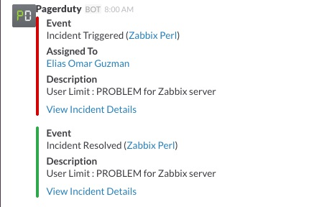
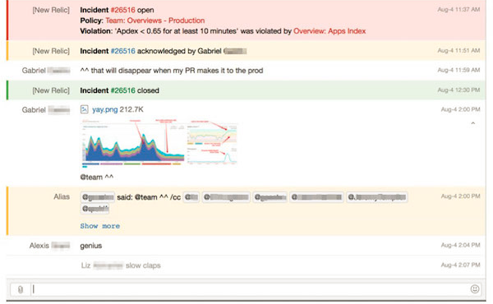
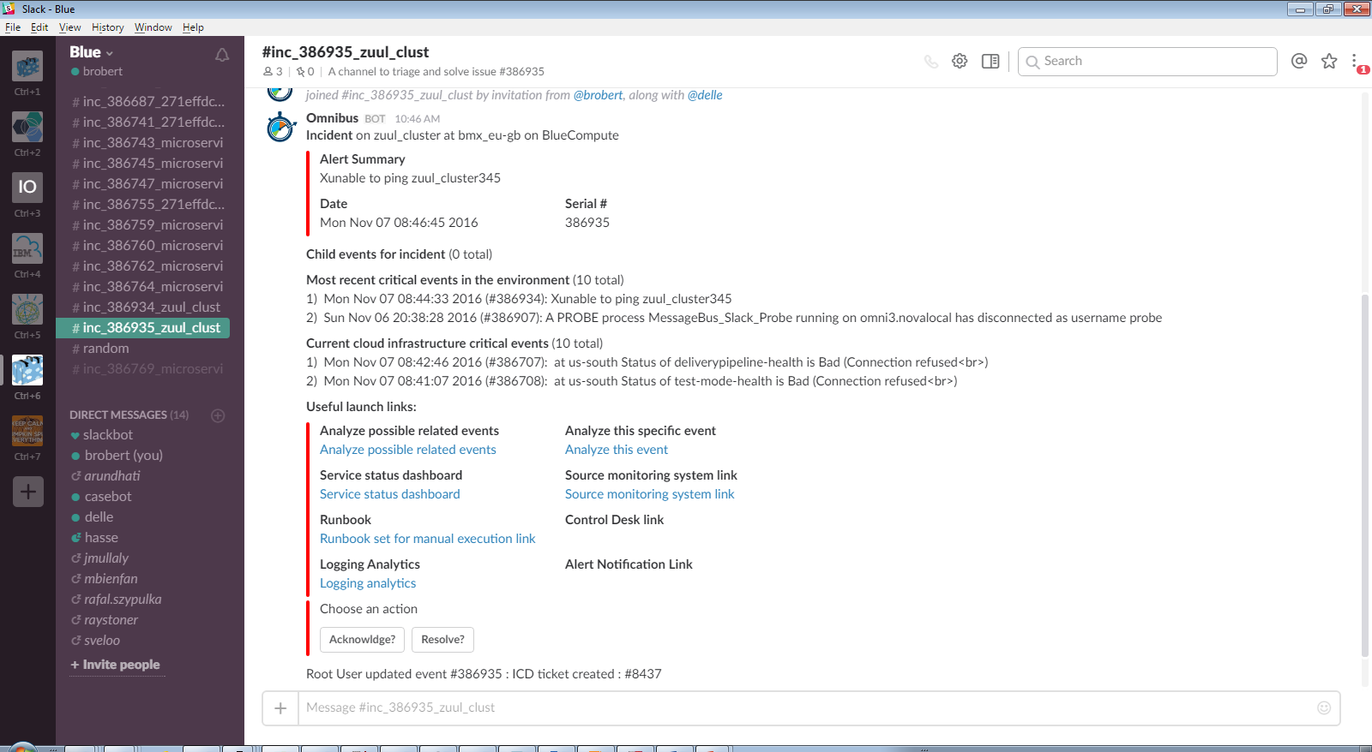
Tools change – ChatOps
More than just a chat tool – a cultural shift towards collaboration, between Humans & Tools
Shorten feedback loops through collaboration
Integrated Notification & Persistency
Integration of various information feeds through APIs
Automatic actions / responses through bots, chatBots
4
Notes:
Not yet another “virtual collaboration” tool that silos conversations and information into yet another place to look for relevant information.
https://www.box.com/blog/securing-chatops-enable-devops/
https://www.pagerduty.com/blog/what-is-chatops/
https://vividcortex.com/blog/2014/06/02/chatops-at-vividcortex/
https://www.youtube.com/watch?v=NST3u-GjjFw

Slide 5
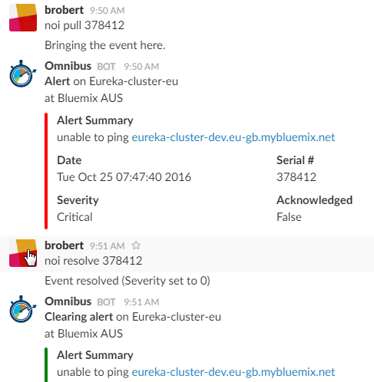
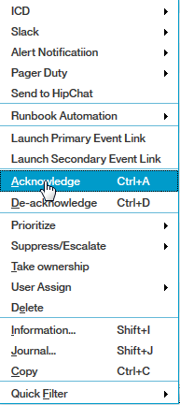
ChatOps Value Proposition in ITSM
Collaboration, put to work
All tools available in chat, less context-switching.
Pull people into issue, don’t move issue from person to person.
Accessible history of issue, record of attempts to solve issue, available for problem management.
Re-using a tool that is already used, not adding a new tool.
5

Slide 6

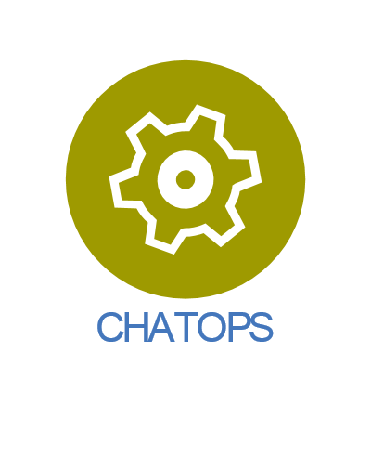
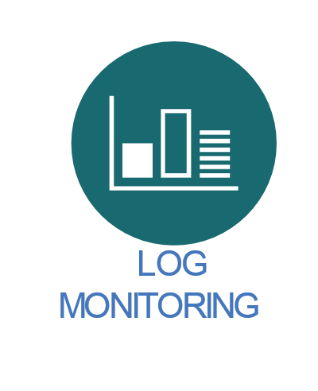







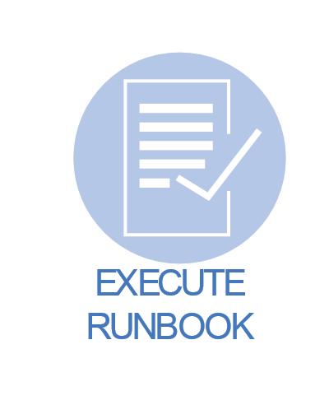

Lifecycle of an event
3
6
1
5
6
2
5
1
7
4
6
4

Slide 7
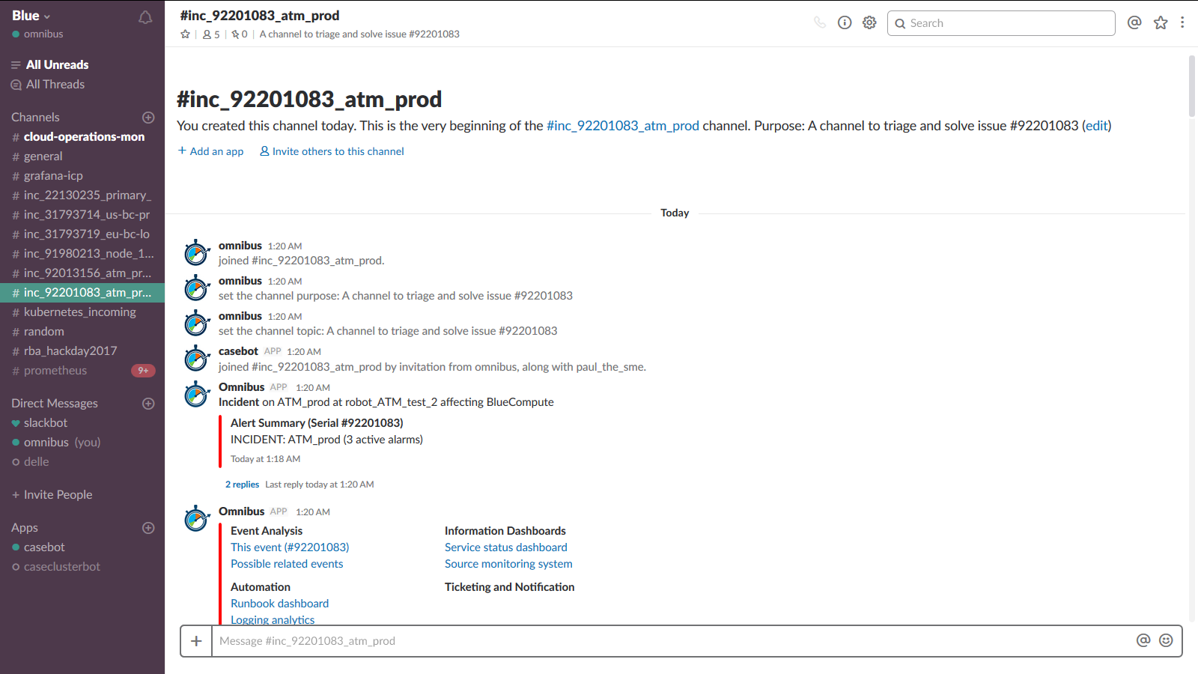
Incoming event, gets a dedicated channel
Auto-invite the relevant SME
Event details, including impacted service
Drill down links

Slide 8
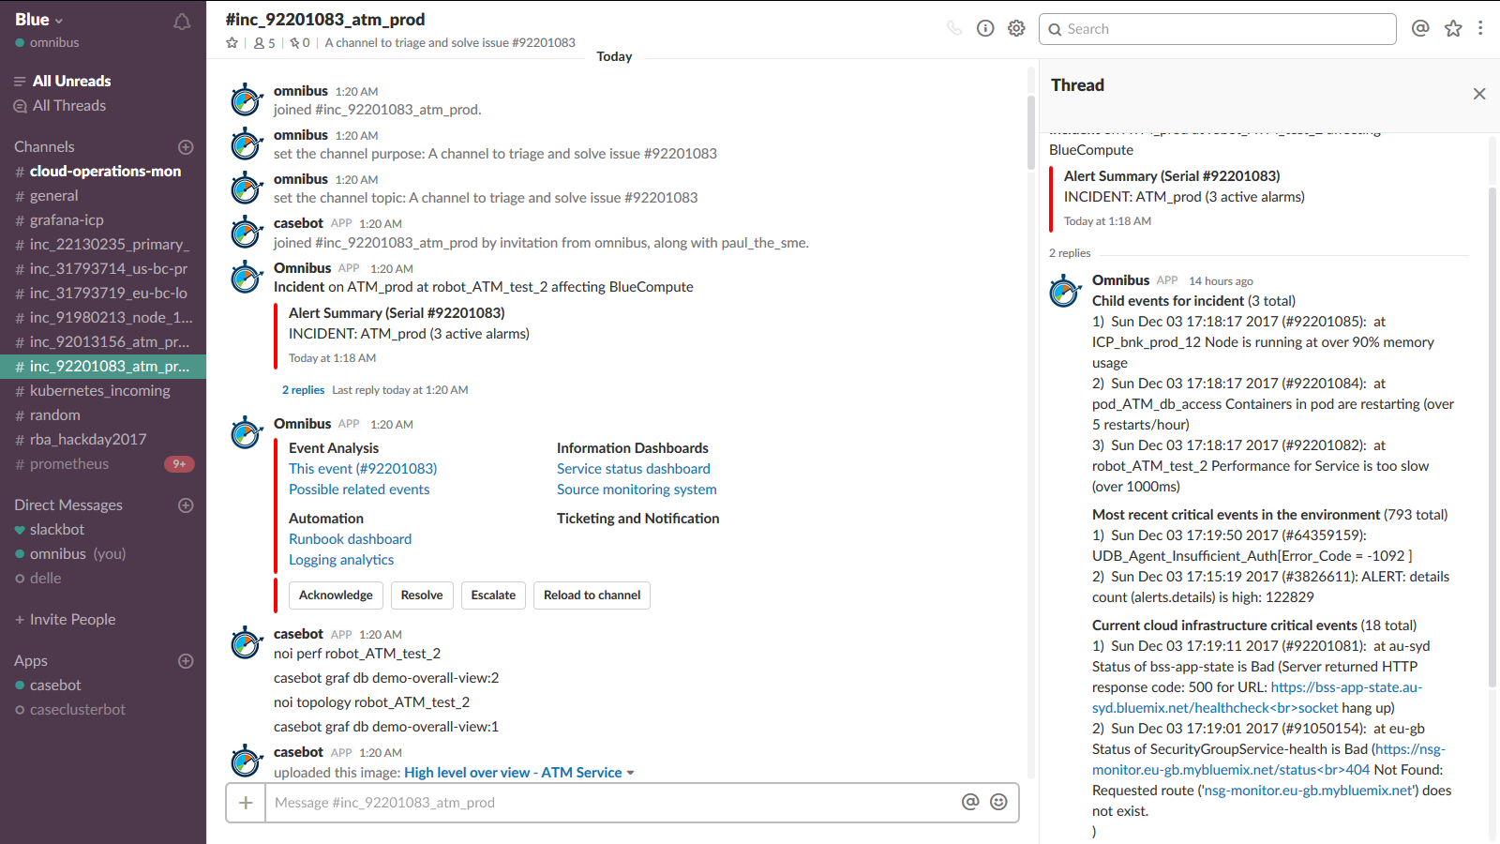
Sub events folded into thread to save space in channel
Child events
Other critical events (further context for first responder)
Platform event (further context for first responder)

Slide 9
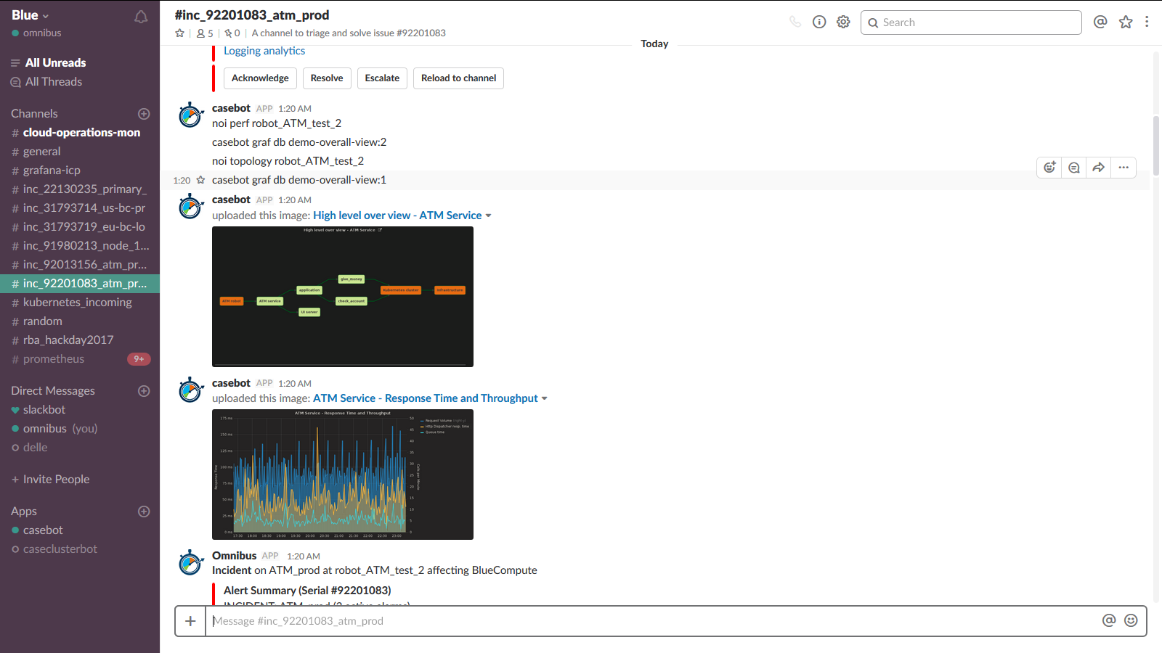
Buttons to automate commands
Automatically pull topology graph into channel
Automatically pull performance graph into channel

Slide 10
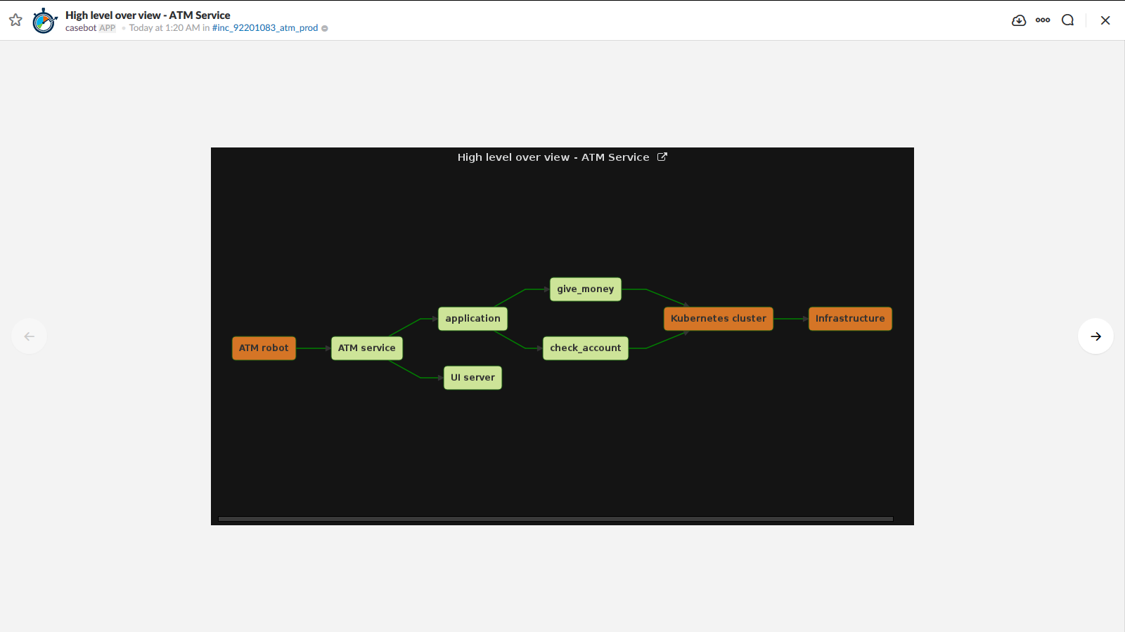
Closeup of topology chart

Slide 11
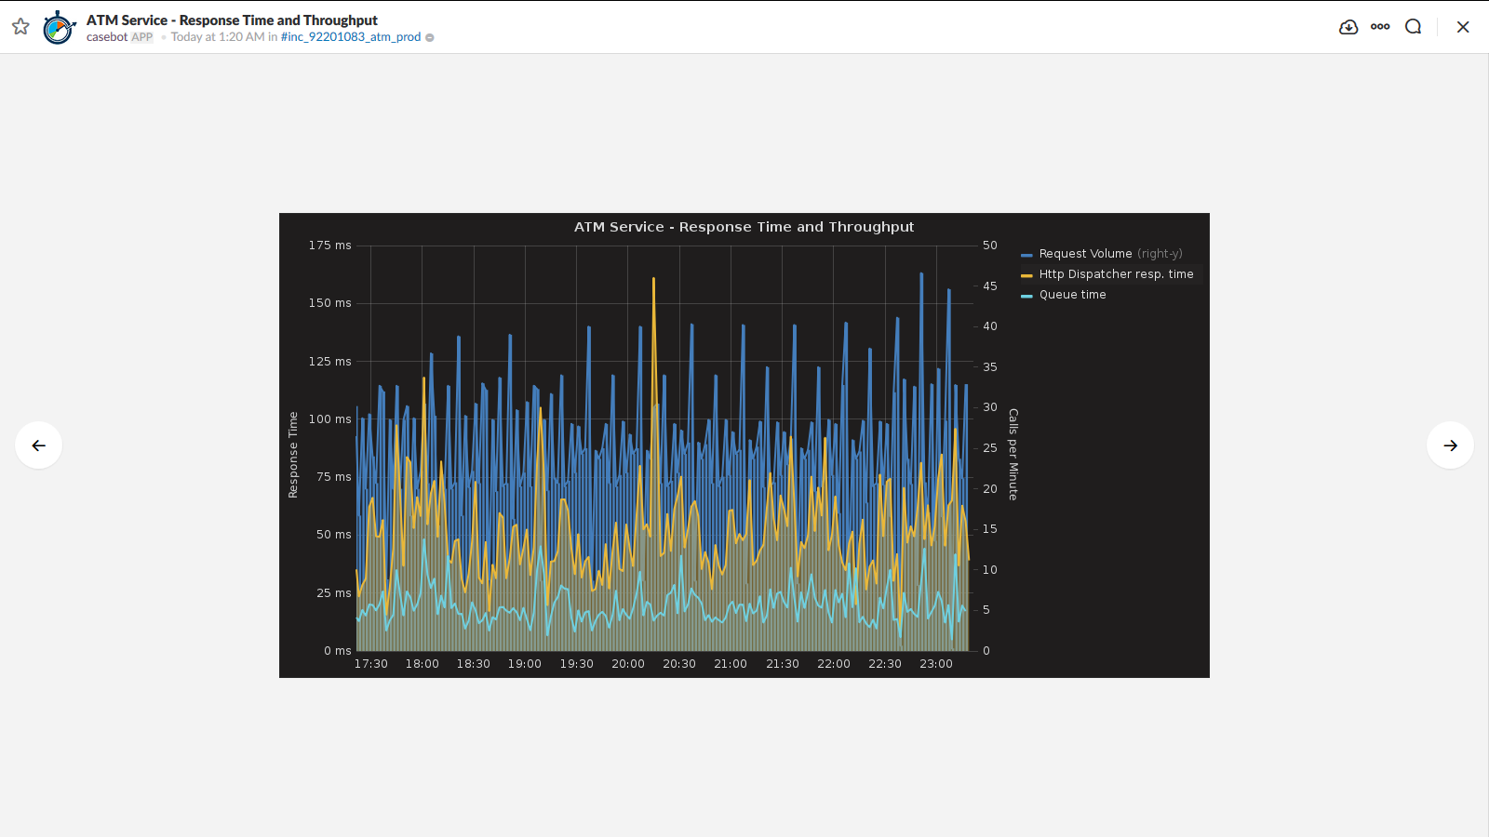
Closeup of Performance chart

Slide 12
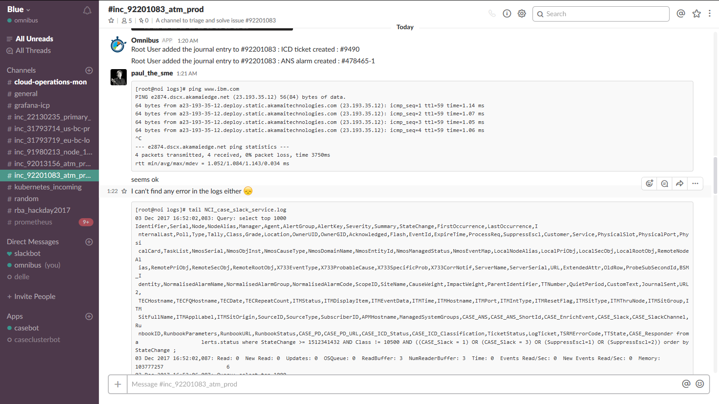
Automatic trouble ticketing/notification
SME copy/pastes results of command into channel, for future use

Slide 13
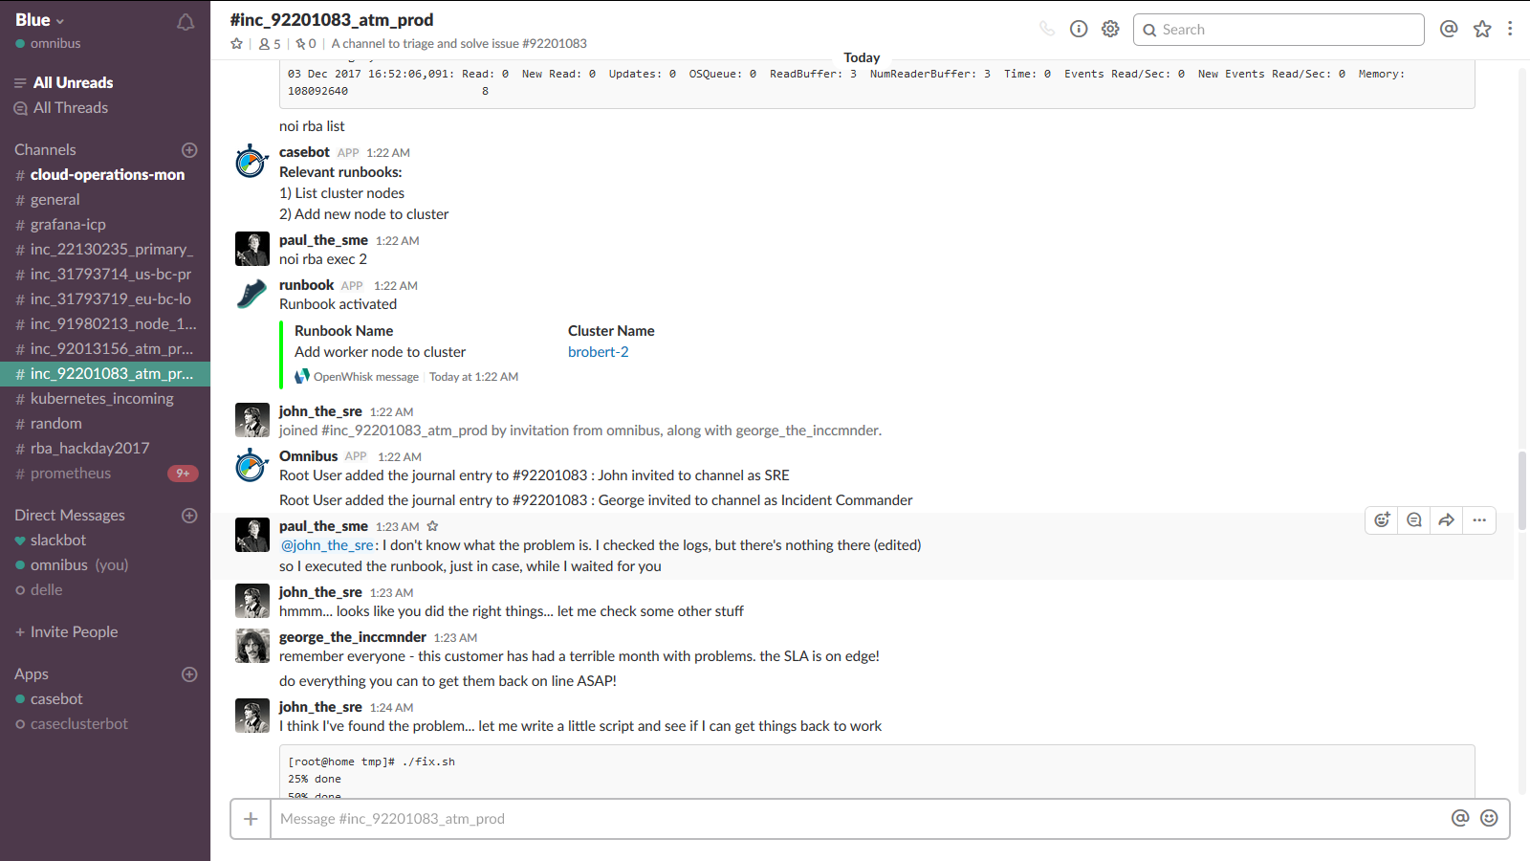
List available/relevant runbooks
Execute specific runbook
Runbook returns result
Escalate and bring SRE & Incident Manager into channel (either automatically or manually)

Slide 14
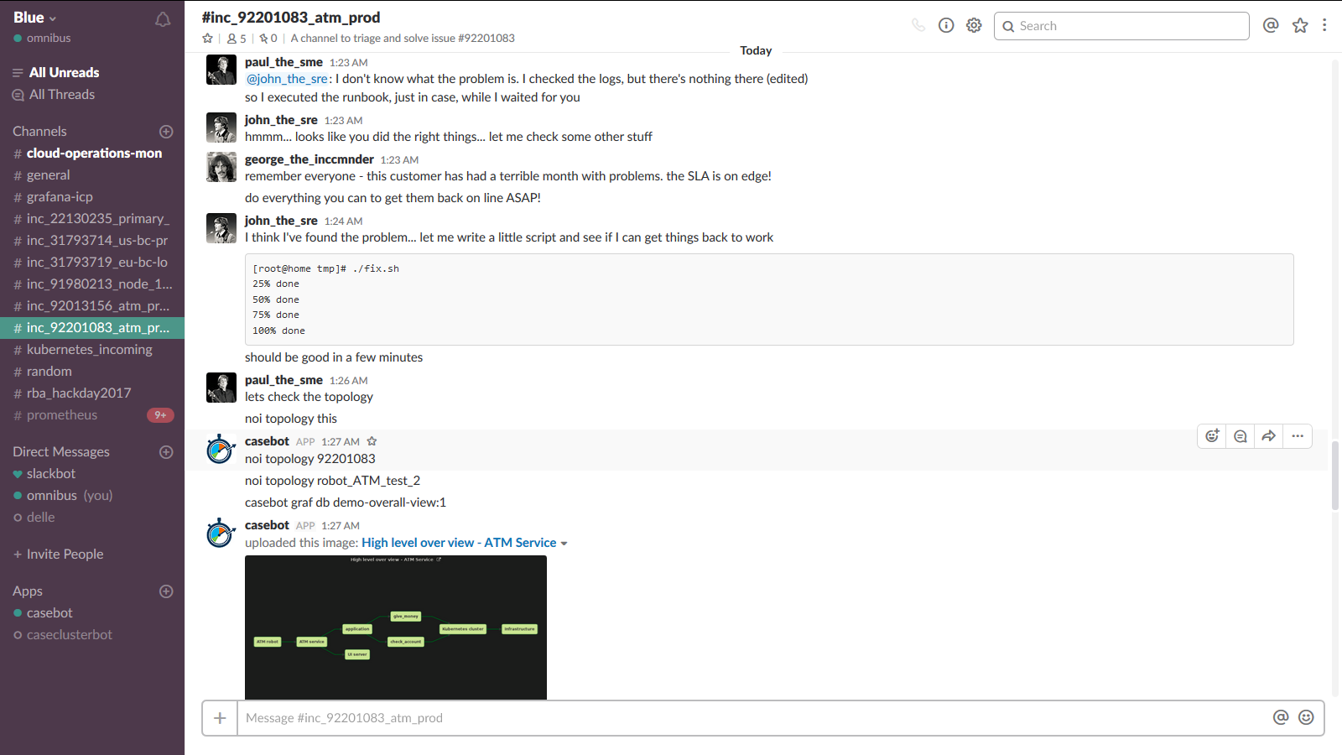
SRE adds input, reads what SME has already done
Incident Commander manages vis-à-vis customer
After solution, check dashboards again

Slide 15
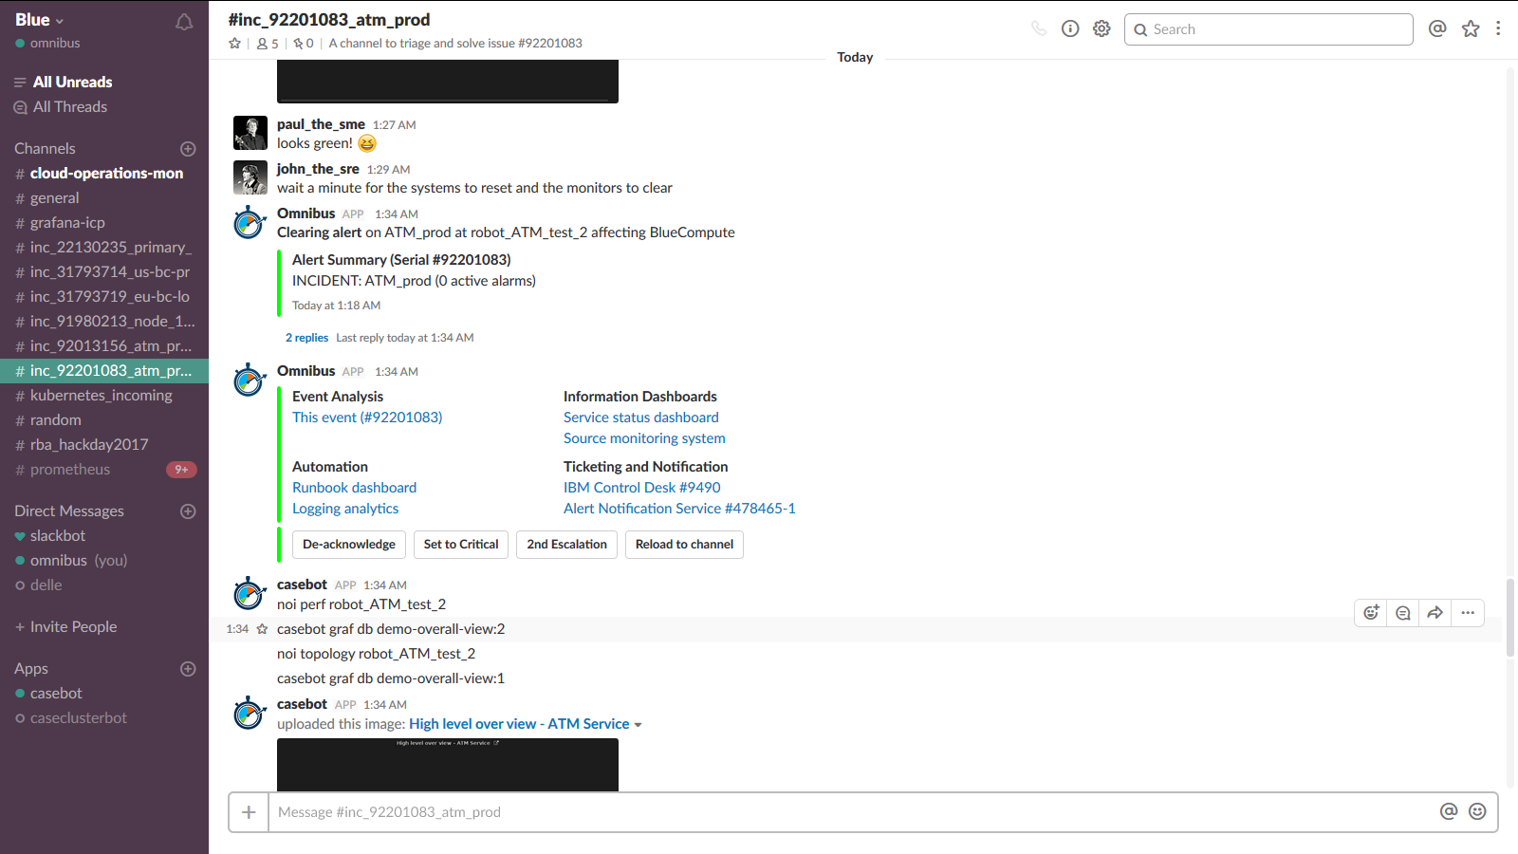
Event closes, sends a clearing event to channel

Slide 16
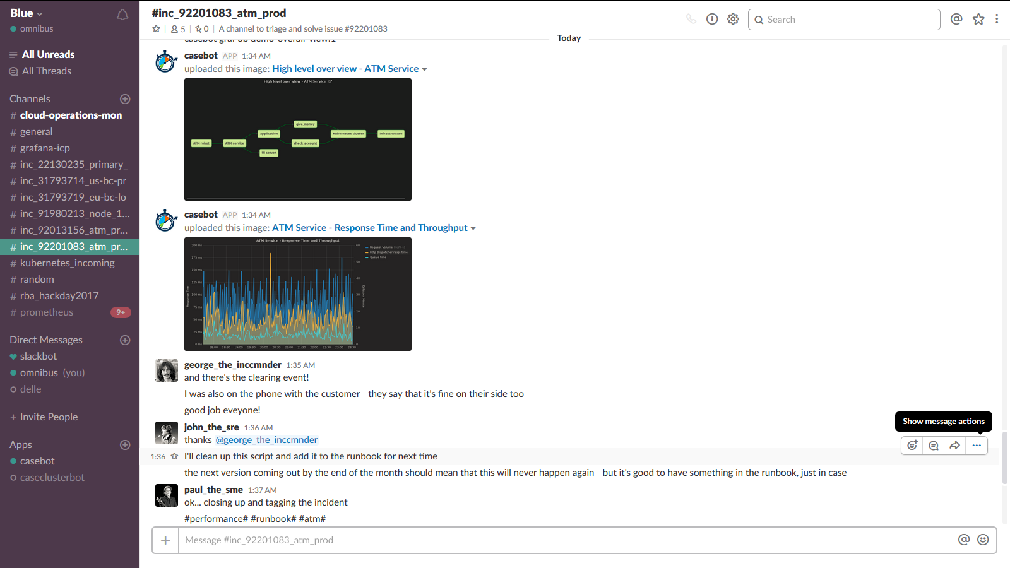
Add backlog tasks to avoid recurrence of incident
Tag for data mining/trending

Slide 17
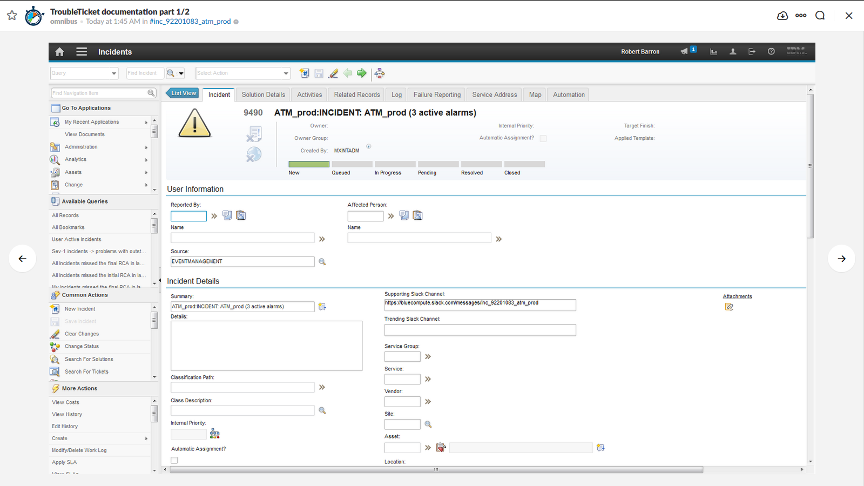
Channel details in trouble ticket

Slide 18
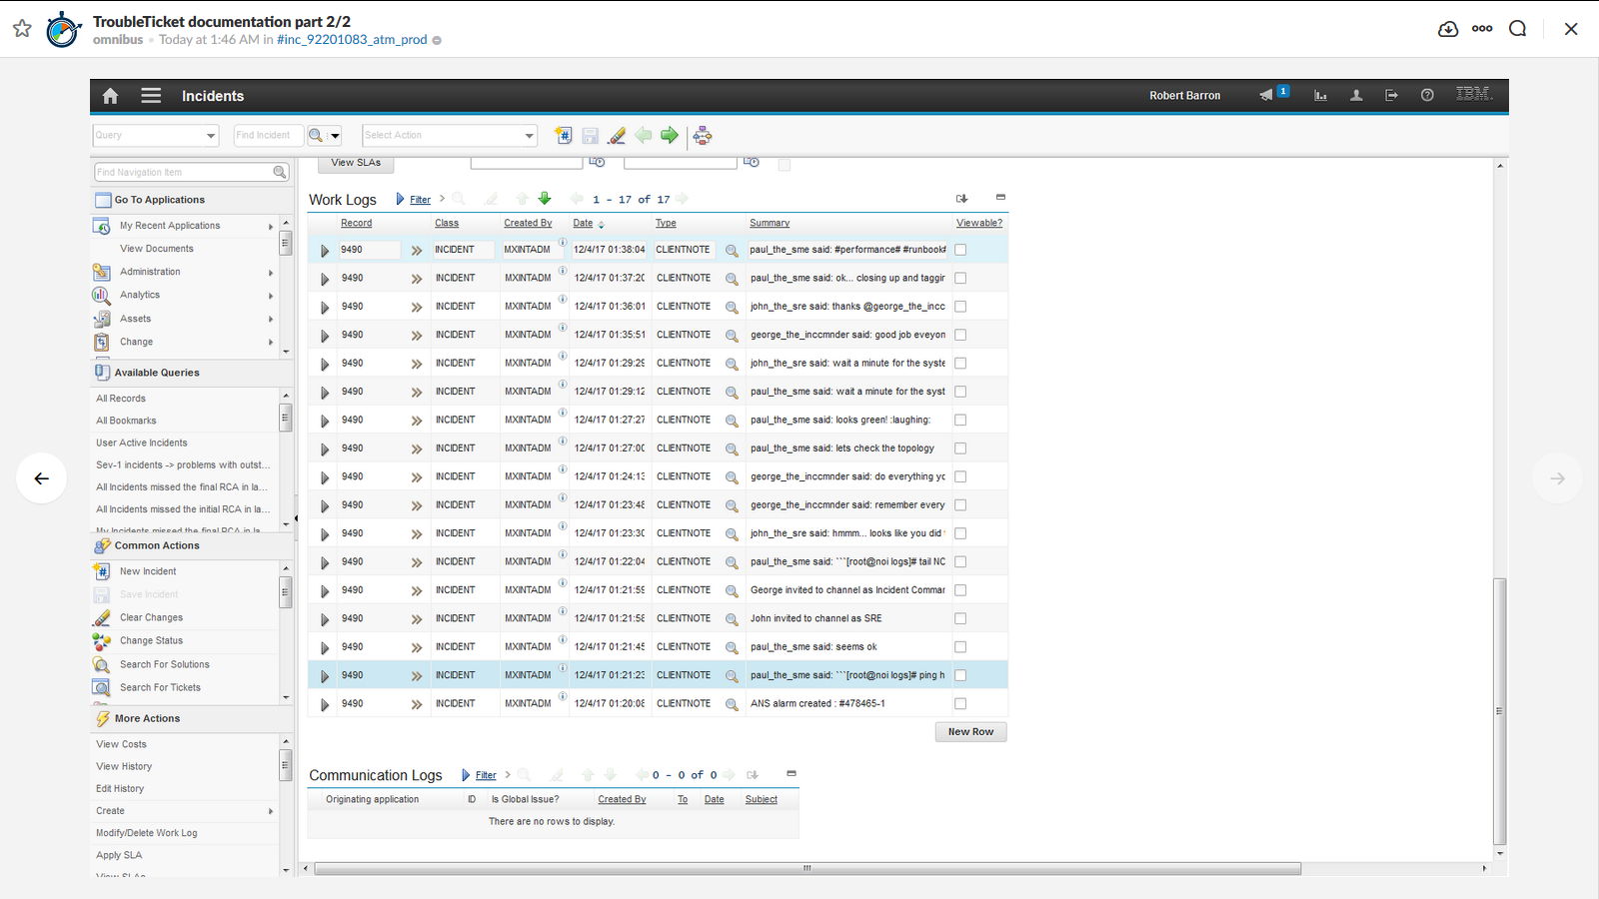
Channel conversation stored in ticket

